Slide 1

Python Web Scraping
Osam-Frimpong, Schandorf
@osamfrimpong
Python Ho Developers Meetup
April 27, 2019

Slide 2
Outline
Introduction and definitions
A few considerations
Pre-requisite knowledge
Tools needed
Practical/Demonstration
Where to go next
References

Slide 3
Introduction and Definitions
Web scraping is a set of techniques for extracting information from the web and transforming it into
structured data that we can store and analyze.

Slide 4
A few considerations
Is web scraping legal?
When is web scraping useful?
Limit requests, protect privacy, play nice...

Slide 5
A few considerations
Is web scraping legal?
When is web scraping useful?
Limit requests, protect privacy, play nice...

Slide 6
Pre-requisite knowledge
A basic knowledge or understanding of the document (HTML,XML,JSON) structure.

Slide 7
Pre-requisite knowledge
Be familiar with the Python programming language (import, functions, loops, conditionals, lists).
Running python files from the command line.

Slide 8
Tools Needed
Web browser; chrome, Firefox
Text editor; sublime text, vs code
Command prompt, power shell, or terminal
Good Internet connection

Slide 9
Python Packages
Requests – http(s) requests
Urllib.request - downloads
BeautifulSoup4 – html parsing
Os – system commands
Time - timer

Slide 10
Practical Walkthrough

Slide 11
A typical Web Scraper!
Step 1: Downloading Contents from Web Pages.
Step 2: Extracting Data
Step 3: Storing the Data
Step 4: Analyzing the Data

Slide 12
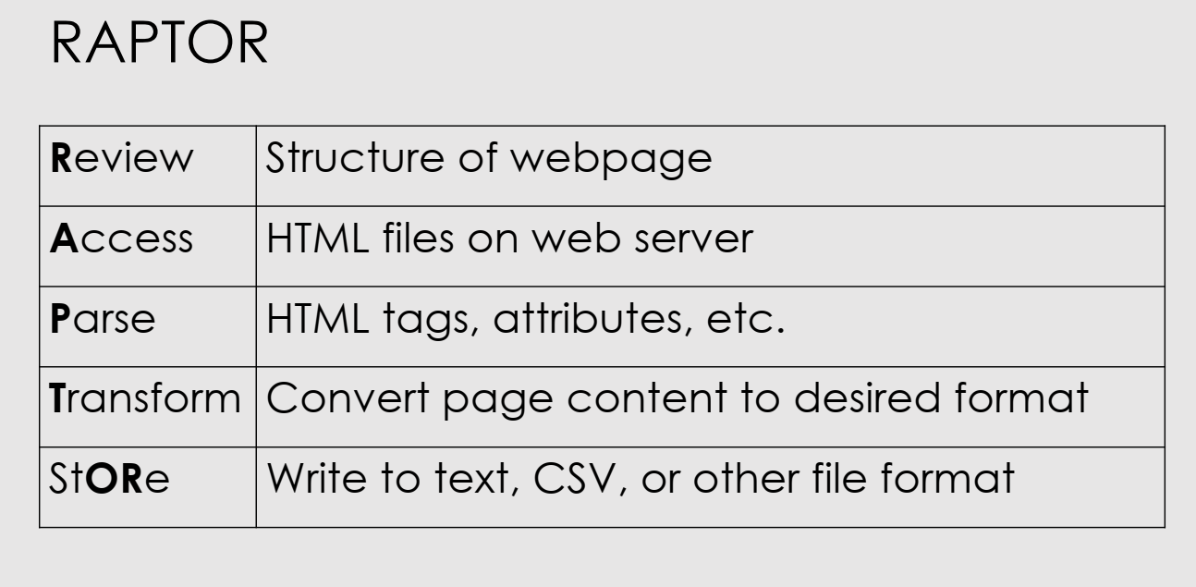
A typical Web Scraper!

Slide 13
Writing Our Script

Slide 14
Install Python Packages
Requests – pip install requests
BeautifulSoup – pip install beautifulsoup4

Slide 15
Writing our script.
Pick a website to scrape
View the source of the page
Inspect the web page

Slide 16
Some HTML tags we’ll use
<body></body>
<div></div>
<a href=“”></a>
<article></article>
<tag attribute=“value”></tag>

Slide 17
What’s Next?
There are more advanced things you can do with web scraping. We just had an introduction to this wonderful world. Explore More!

Slide 18


References
Tutorialspoint.com

Slide 19
Any Questions?
Twitter: @osamfrimpong
Github: @osamfrimpong
E-mail: osamfrimpong@outlook.com

Slide 20
Thank You

